Slide 1
Assignment Three
Data Structures and Object-Oriented Programming
Instructor: Sai-Keung Wong
National Yang Ming Chiao Tung University

Slide 2
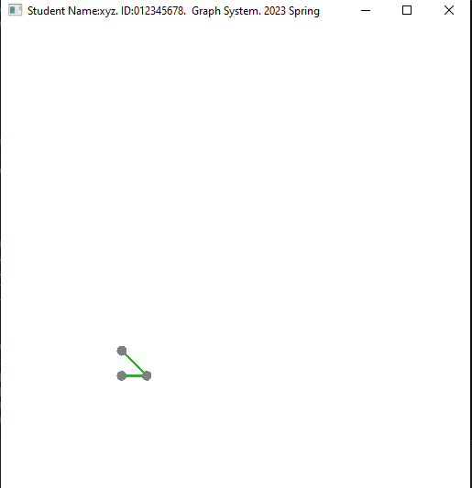
Top bar
edge
node

Slide 3
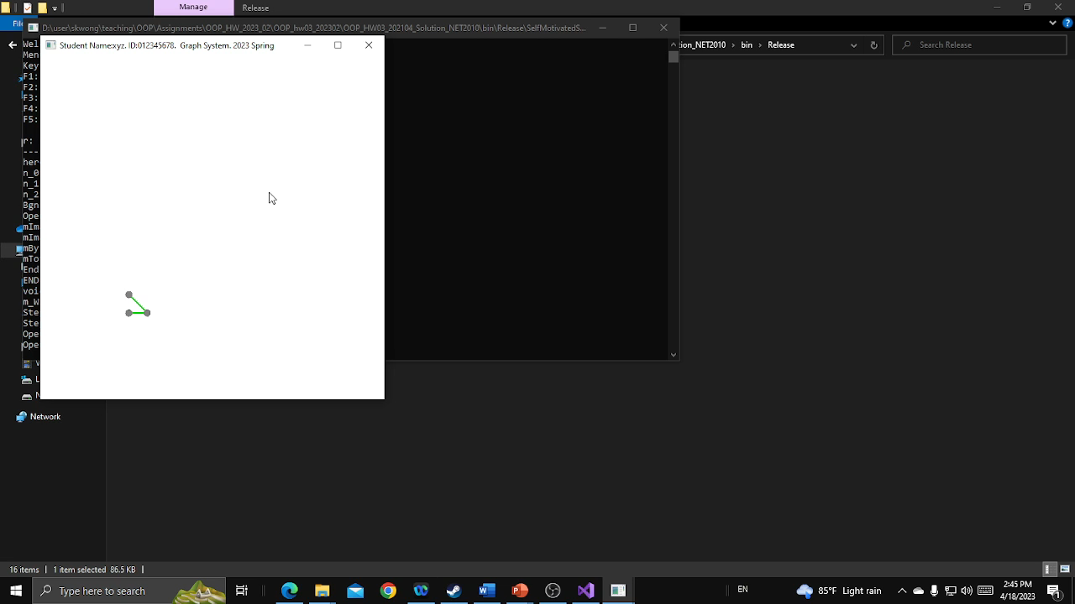
Press ‘1’, ‘2’, …, ‘5’ to change graphs. Use the mouse to zoom in and zoom out.

Slide 4
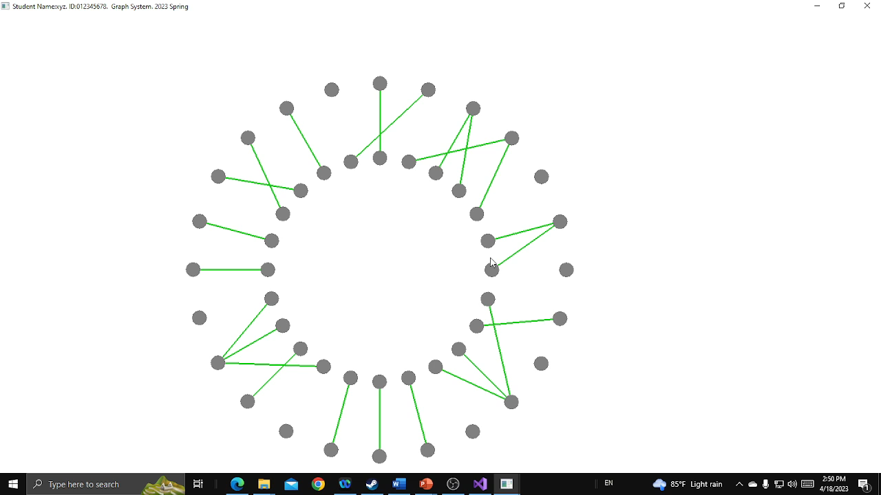
Use the left mouse button to select two nodes to create an edge.
If the same node is clicked twice, it is unselected.

Slide 5
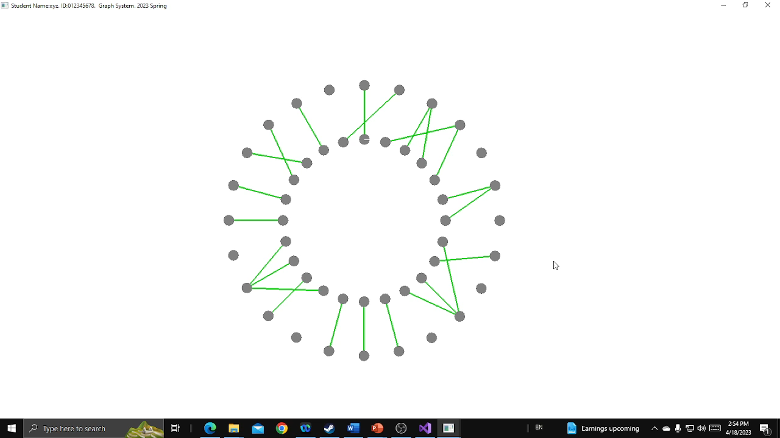
Press ‘d’ to toggle the process for node deletion

Slide 6
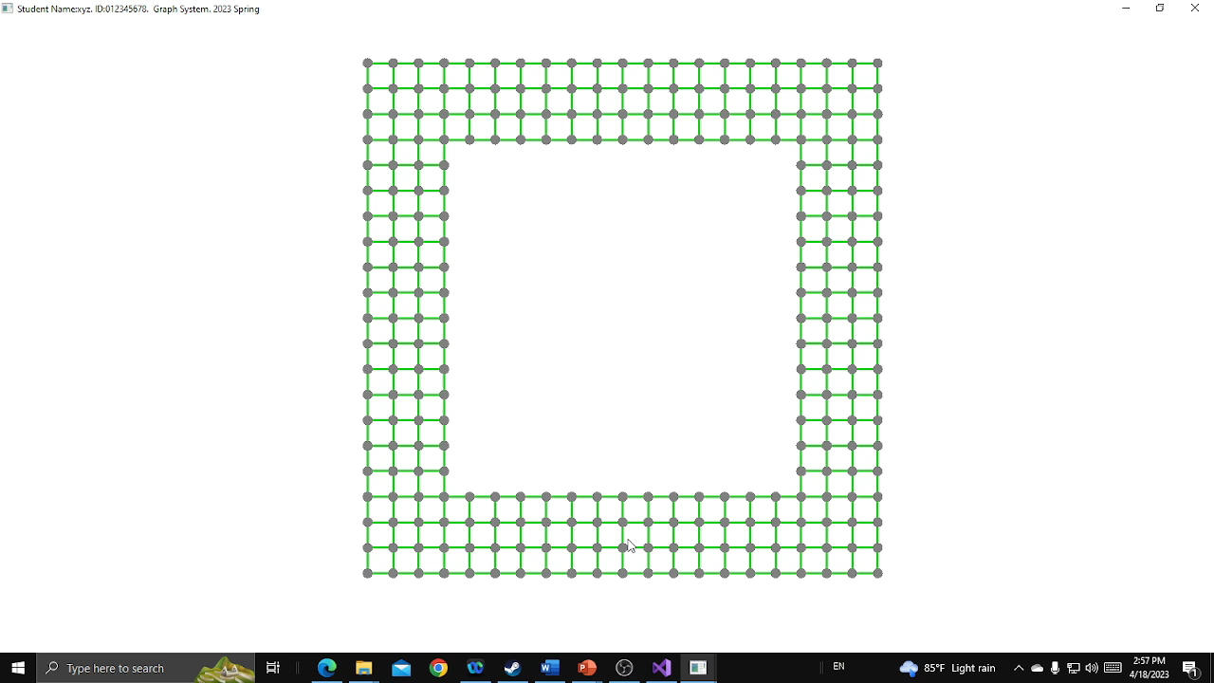
Press ‘d’ to toggle the process for node deletion
Press ‘d’ to activate the node deletion process. Press it the second time to stop the process.
Furthermore, new edges can be created when the node deletion process is stopped.

Slide 7
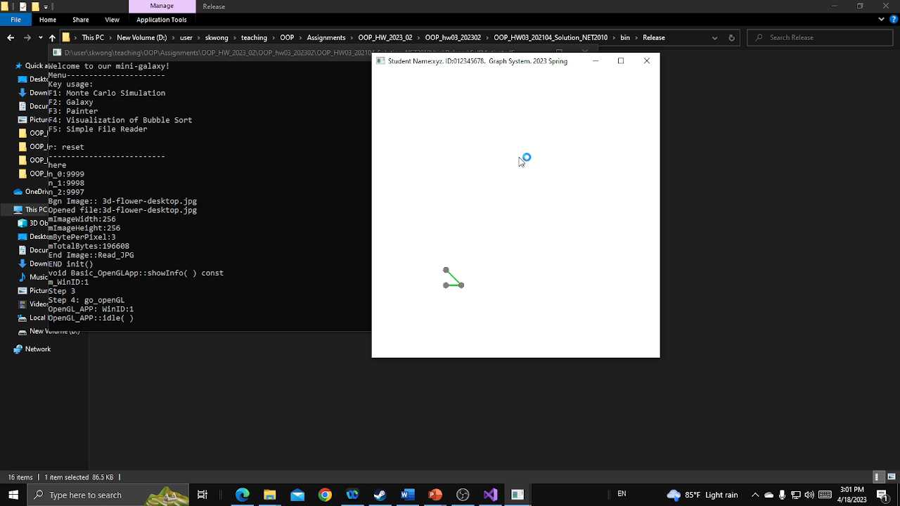
Press F5 to show student information on the top bar.
Press ‘s’ or ‘S’ to show student information on the console window.

Slide 8
Thank you
Data Structures and Object-Oriented Programming
Instructor: Sai-Keung Wong
National Yang Ming Chiao Tung University

